Slide 1
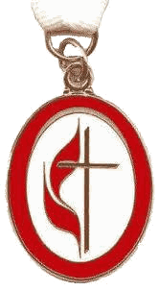
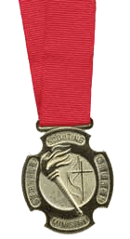
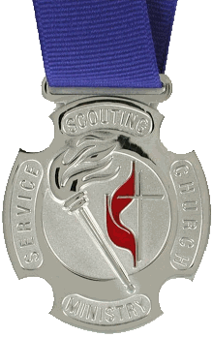
UMC Awards and Recognitions Honoring the Unsung Heroes
Notes:
Our awards let us Honor the Unsung Heroes. We have awards for youth, adults, local churches, and units.
(Print the one-page UMC Awards and Recognitions handout and various awards brochures for each participant.)
(Each Participant also needs a copy of the Scouting and Civic Youth-Serving Ministry Guidelines.)

Slide 2
Awards & Recognitions
Youth:
Local:
District
Confer.:
National:
Church:
Unit:
Good Samaritan, PRAY Awards
Cross & Flame, Life SMS, J Wesley
Torch, Life SMS, John Wesley
Silver Torch, Life SMS, Wesley
Shepherd Church
Bishop’s Award →
Notes:
Good Samaritan & PRAY Awards celebrate the work of our youth. The Cross & Flame is for Scout and UMC youth, Sunday School, etc.
Consider Lifetime SMS and Society of John Wesley as greater recognition for leaders at all levels.
Shepherd Church award recognizes churches and the Bishop’s Award is for Units.

Slide 3
Good Samaritan Award
Age:
Years:
Level:
Req.:
Award:
Cost:
6 – 30
n/a
Local Church
Lead a Project
Medal, Certificate, Pin
$60 →
Notes:
The Good Samaritan is a rare Award that recognizes a project led by a single youth.
The project may be an Eagle Scout project or any youth-led project to help others.
The brochure/application describes the medal, certificate, and pin.

Slide 4
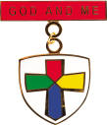
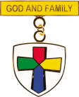
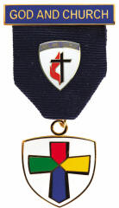
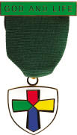
PRAY Awards
Age:
Years:
Level:
Req.:
Award:
Cost:
Grades: 1-3 3-5 6-8 9-12
n/a
Local Church
PRAY Curriculum
Medal, Certificate, Pin
Book $5 Medal $10 →
Notes:
The PRAY Awards are age-based curriculum for Grades 1-3, 4-5, 6-8, and 9-12.
There are student, counselor, and mentor materials for each level.
Awards include medals, certificates, and pins. A BSA recipient can wear the BSA Youth Religious knot.

Slide 5
Cross and Flame Award
Age:
Years:
Level:
Req.:
Award:
Cost:
Adult, no UMC req.
3+
Local Church
UMC + Youth Organization
Medal, Certificate, Pin
$50 →
Notes:
The Cross and Flame Award is for local Scouting leaders and UMC youth, Sunday School, etc.
Minimum least 3 years youth leadership inside and outside their local United Methodist Church..
The brochure/application describes the medal and certificate. A BSA recipient can wear the BSA Adult Religious knot.

Slide 6
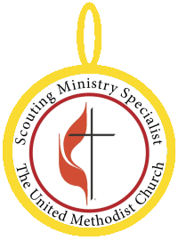
Lifetime Scouting Ministry Specialist
Age:
Level:
Req.:
Award:
Cost:
Adult
Any
Self nomination allowed
Certificate, Patch
$250 →
Notes:
You can present the Lifetime Scouting Ministry Special membership to a leader at any level.

Slide 7
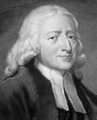
Society of John Wesley
Age:
Level:
Req.:
Award:
Cost:
Any
Any
Self nomination allowed
Certificate, Pin
$1,000 →

Slide 8
Torch Award
Age:
Years:
Level:
Req.:
Award:
Cost:
Adult, UMC Member
4+
District or Conference
UMC + Youth Organizations
Medal, Certificate, Pin
$50 →
Notes:
The Torch Award is for District and Conference Scouting leaders and UMC youth leaders.
Minimum least 4 years, one per Conference one per 100,000 members in the conference.
The brochure/application describes the medal and certificate. A BSA recipient can wear the BSA Adult Religious knot.

Slide 9
Silver Torch Award
Age:
Years:
Level:
Req.:
Award:
Cost:
Adult
No minimum
Jurisdictional or National
UMC + Youth Organizations
Medal, Certificate, Pin
$75 →
Notes:
The Silver Torch Award is for Jurisdictional, national, and world youth leaders.
No minimum years but exemplary service is required.
The brochure/application describes the medal and certificate. A BSA recipient can wear the BSA Adult Religious knot.

Slide 10
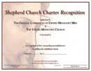
Shepherd Church Charter Recognition
Level:
Req.:
Award:
Cost:
Local Church
Sponsor a unit, PRAY Program,
Scout Sunday, Service Projects
Certificate
$25 →
Notes:
The Shepherd Church Charter Recognition is for a local church who sponsor Troops, Packs, Crews, or Clubs.
In addition, the local church must include the PRAY Program, Scout Sunday, and Service Projects.
There is a certificate explained in the brochure/application.

Slide 11
Bishop’s Award of Excellence
Level:
Req.:
Award:
Cost:
Unit/Club
Mission project, Scout Sunday,
PRAY Program, Yearly Plan
Certificate, Patch
$50 →
Notes:
The Bishop’s Award of Excellence is for Troops, Packs, Crews, and Clubs.
Their yearly plan will need to include an annual Mission project, Scout Sunday, use of the PRAY Program.
There is a certificate and patch explained in the brochure/application.

Slide 12
Who are your unsung heroes?
Candidates for:
Good Samaritan
Cross & Fame
Lifetime SMS
Society of John Wesley
Torch/Silver Torch
Shepherd Church
Bishop’s Award →
Notes:
Who are your unsung heroes? Good Samaritan, PRAY Awards celebrate youth. Cross & Flame is for local church leaders.
Lifetime SMS and Society of John Wesley can provide greater recognition for leaders at all levels. Torch & Silver Torch for higher levels.
Shepherd Church award recognizes churches and the Bishop’s Award is for Units.

Slide 13
General Commission
on United Methodist Men
Contact:
Marc Stowe
www.umscouting.com
mstowe@gcumm.org
615-620-7262
Notes:
For more information, please contact the General Commission on United Methodist Men (GCUMM).
Any questions?

